Slide 1
DealFinder
BPMN Diagram
Presented by -
Ridwanul Hasan Tanvir (1705016)
Group 2 (A1)

Slide 2
Websites we will scrape:
Groceries and daily necessities
Meena-Click : https://www.meenaclick.com/
Shwapno : https://www.shwapno.com/
Chaldal.com : https://chaldal.com/
Electronics
Pickaboo : https://www.pickaboo.com/
Startech : https://www.startech.com.bd/
Ryan’s : https://www.ryanscomputers.com/

Slide 3
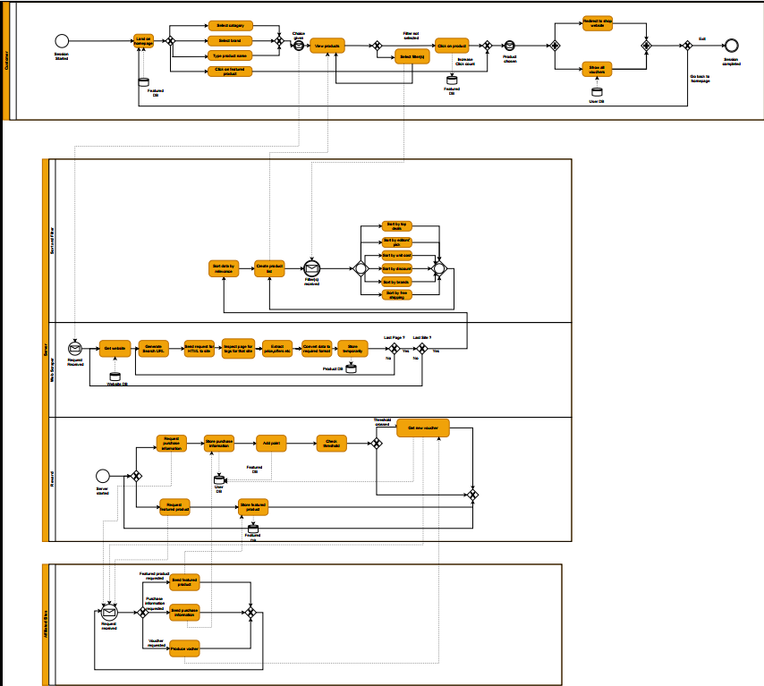
BPMN Diagram

Slide 4
Pools & Lanes
Customer
Server
Web Scraper
Sort & Filter
Rewards
Affiliated Sites

Slide 5
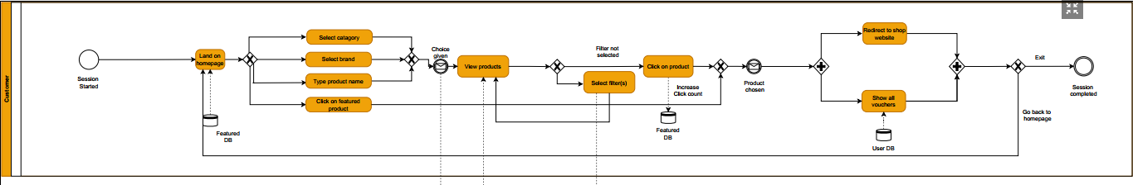
Pool1-Customer

Slide 6
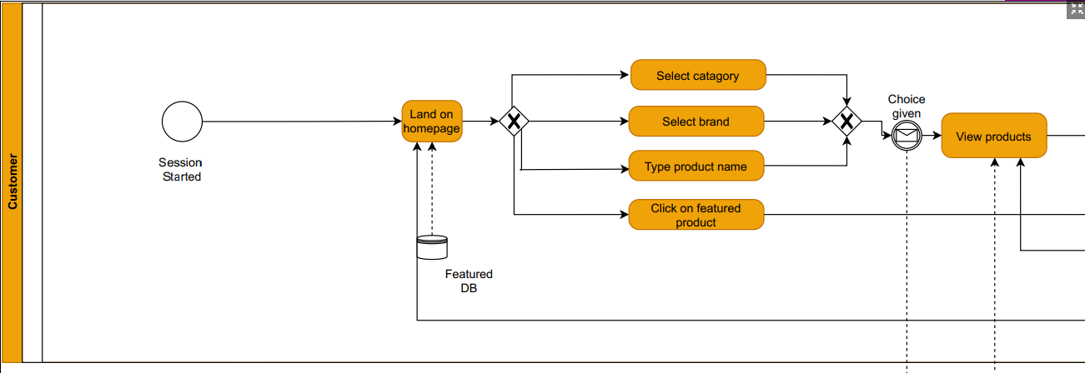
Pool1-Customer

Slide 7
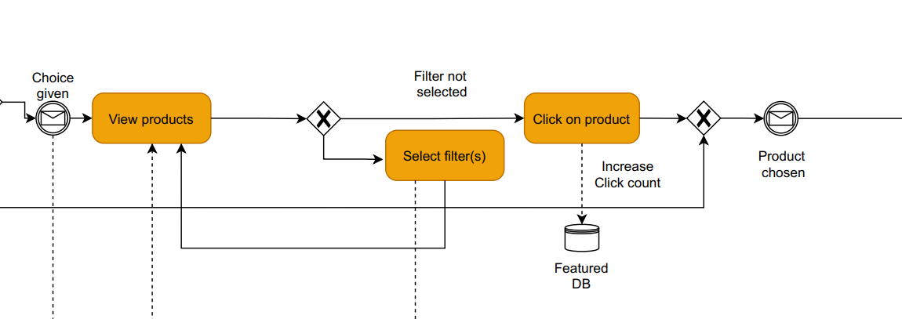
Pool1-Customer

Slide 8
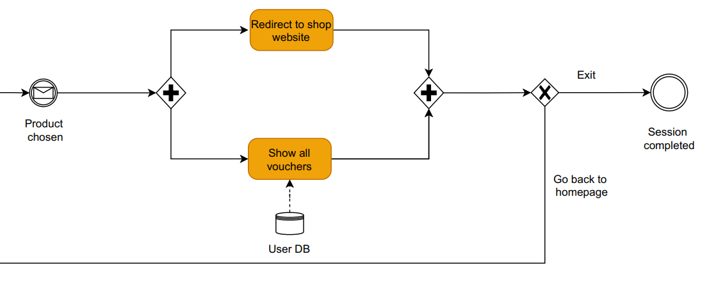
Pool1-Customer

Slide 9
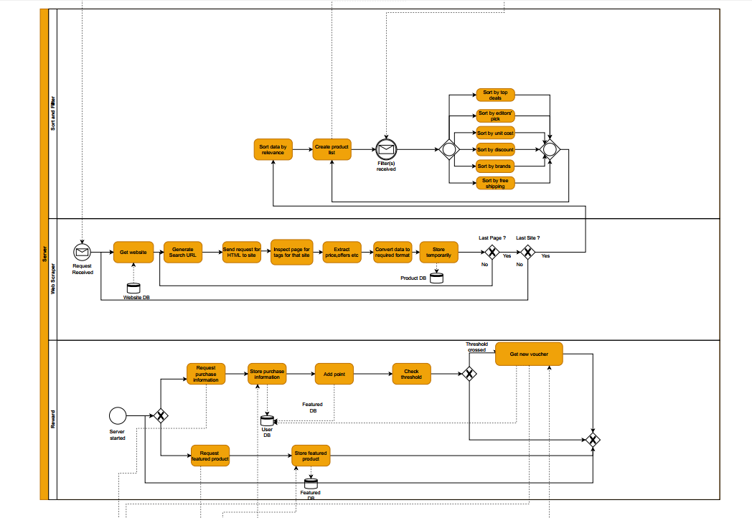
Pool2
Server

Slide 10
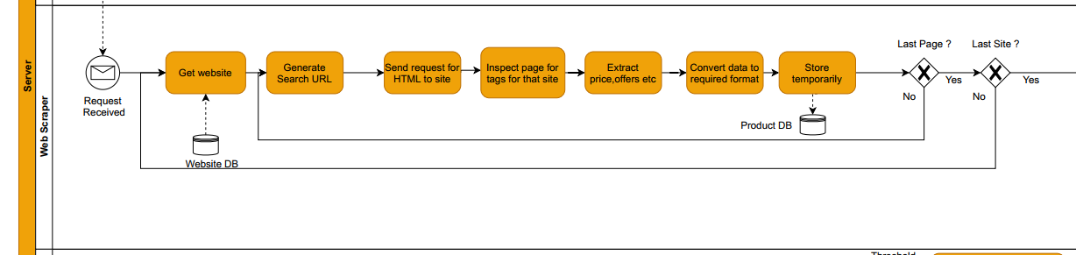
Pool2-Server (Web Scraper)

Slide 11
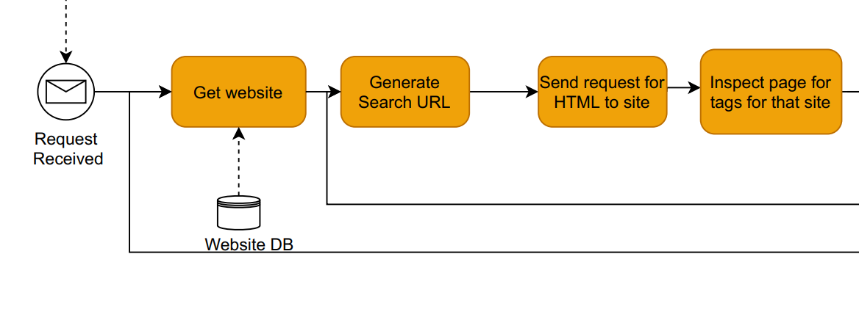
Pool2-Server (Web Scraper)

Slide 12
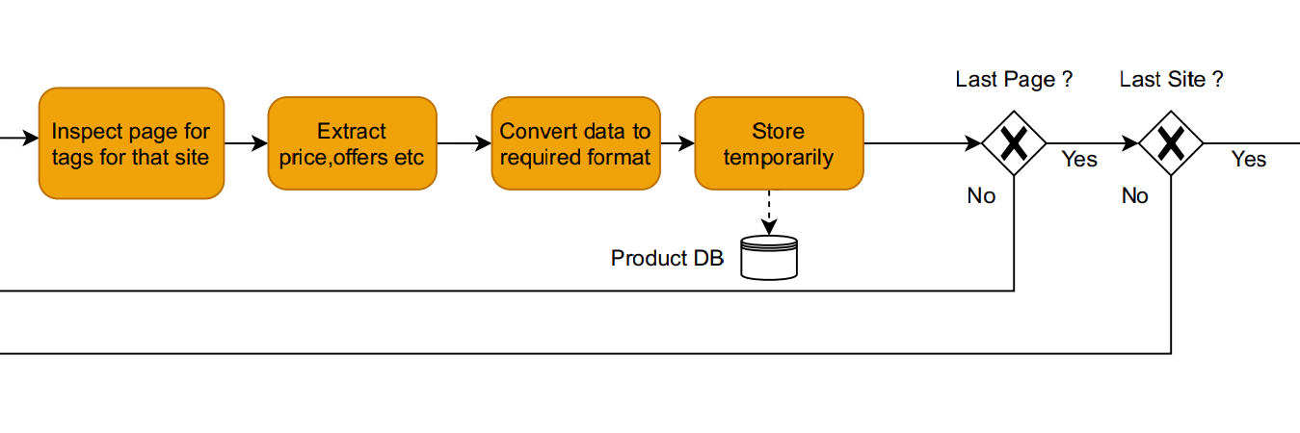
Pool2-Server (Web Scraper)

Slide 13
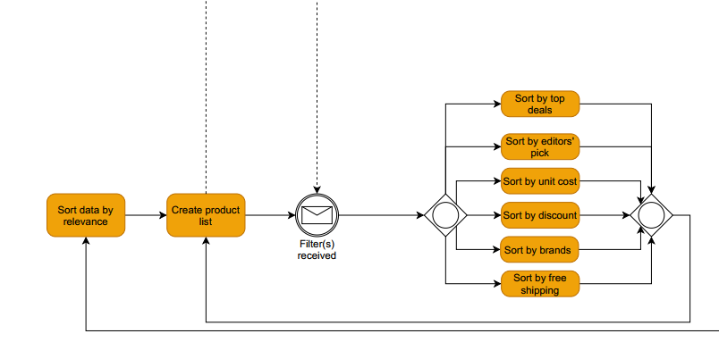
Pool2-Server
(Sort and Filter)

Slide 14
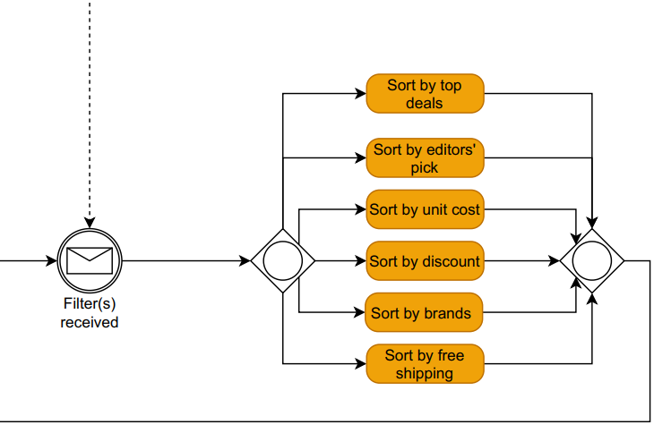
Pool2-Server (Sort and Filter)

Slide 15
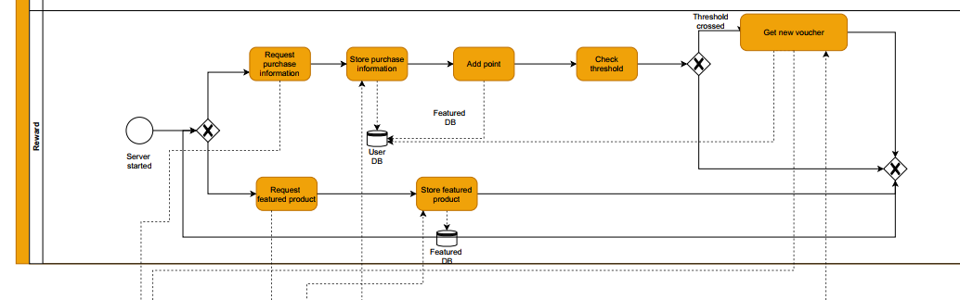
Pool2-Server (Reward)

Slide 16
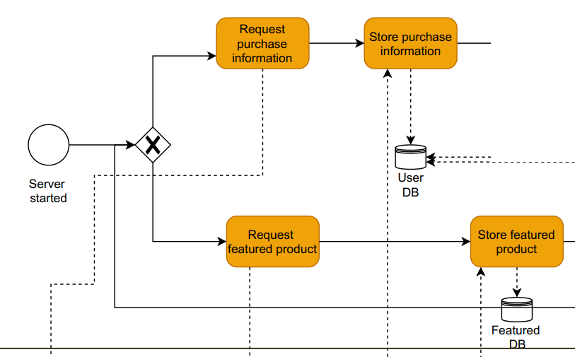
Pool2-Server (Reward)

Slide 17
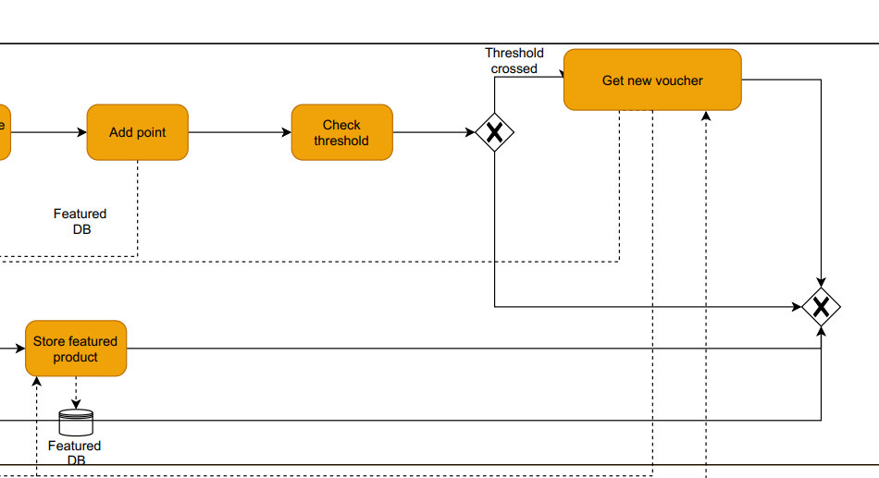
Pool2-Server (Reward)

Slide 18
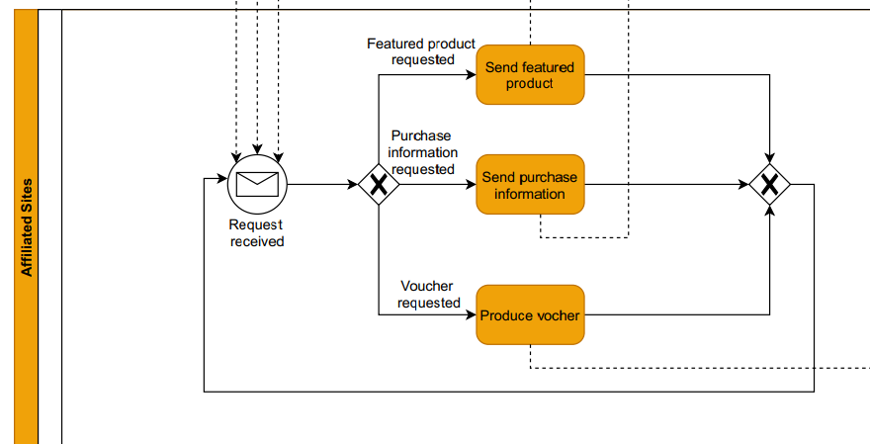
Pool3-Affiliated Sites

Slide 19
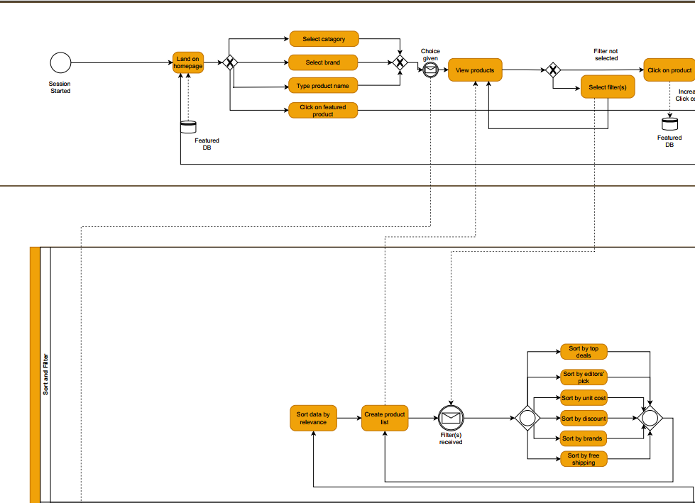
Connection
Between
Customer
and Server

Slide 20
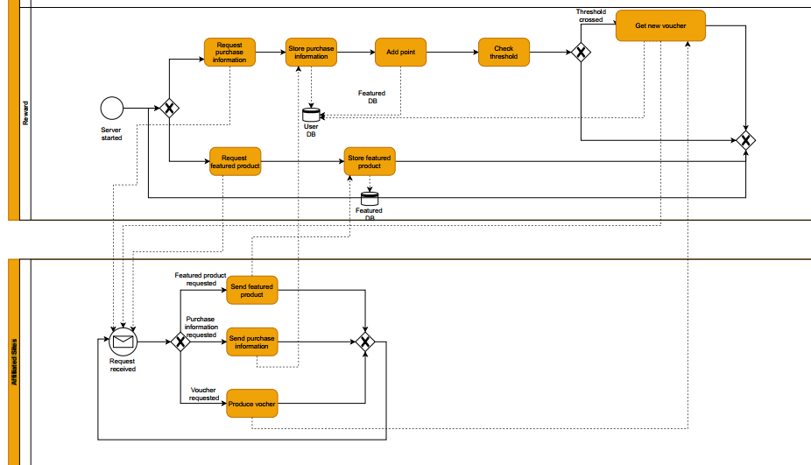
Connection between Affiliated sites and Reward

Slide 21
BPMN
Diagram

Slide 22
Thank you

